Slide 1
18ECE322T - OPTOELECTRONICS

Slide 2
UNIT – 1 - WAVE NATURE OF LIGHT AND SEMICONDUCTOR OPTICS
Light Waves in a Homogeneous Medium- Plane Electromagnetic Wave, Maxwell’s Wave Equation - Refractive Index and Dispersion- Sellmeier Equation and Diamond, Cauchy Equation and Diamond - Polarization of Light - Snell’s Law and Total Internal Reflection - Reflection and Refraction - Superposition and Interference of Waves - Diffraction Principles- Fraunhofer Diffraction, Diffraction Grating
Overview of Semiconductors - Interaction of Photons With Charge Carriers - Hole Pair Formation and Recombination - Absorption in Semiconductors - Effect of Electric Field on Absorption - Absorption in Quantum Wells - Radiation in Semiconductors - Heterojunctions

Slide 3
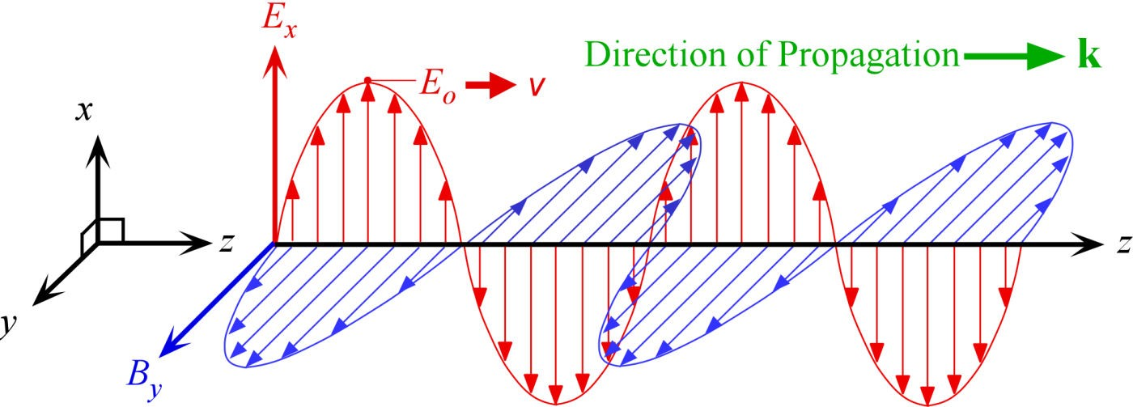
Light is an electromagnetic wave
An electromagnetic wave is a traveling wave that has time-varying electric and magnetic fields that are perpendicular to each other and the direction of propagation z.

Slide 4
E_{x} = E_{o} cos(ωt − kz + φ_{ο})
E_{x} = Electric field along x at position z at time t
k = Propagation constant = 2π/λ
λ = Wavelength
ω = Angular frequency = 2πυ (υ = frequency)
E_{o} = Amplitude of the wave
φ_{ο} = Phase constant; at t = 0 and z = 0, E_{x} may or may not necessarily be zero depending on the choice of origin.
(ωt − kz + φ_{ο}) = φ = Phase of the wave
This is a monochromatic plane wave of infinite extent traveling in the positive z direction.

Slide 5
Wavefront
A surface over which the phase of a wave is constant is referred to as a wavefront
A wavefront of a plane wave is a plane perpendicular to the direction of propagation
The interaction of a light wave with a nonconducting medium (conductivity = 0) uses the electric field component E_{x} rather than B_{y}.
Optical field refers to the electric field E_{x}.

Slide 6
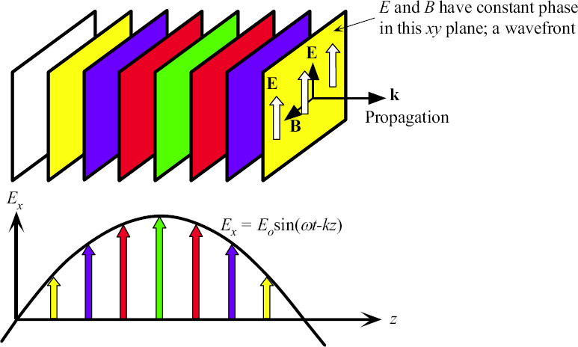
A plane EM wave traveling along z, has the same E_{x} (or B_{y}) at any point in a given xy plane. All electric field vectors in a given xy plane are therefore in phase. The xy planes are of infinite extent in the x and y directions.

Slide 7
Phase Velocity
The time and space evolution of a given phase φ, for example that corresponding to a maximum field is described by
φ = ωt − kz + φ_{ο} = constant
During a time interval δt, this constant phase (and hence the maximum field) moves a distance δz. The phase velocity of this wave is therefore δz/δt. The phase velocity v is
δz ω
v = _{δt} = _{k} = υλ

Slide 8
φ = ωt − kz + φ_{ο}
Phase change over a distance Δz
Δφ = kΔz
The phase difference between two points separated by Δz is simply kΔz
since ωt is the same for each point
If this phase difference is 0 or multiples of 2π then the two points are in phase. Thus, the phase difference Δφ can be expressed as kΔz or 2πΔz/λ

Slide 9
Exponential Notation
Recall that
cosφ = Re[exp(jφ)]
where Re refers to the real part. We then need to take the real part of any complex result at the end of calculations. Thus,
E_{x}(z,t) = Re[E_{o}exp(jφ_{ο})expj(ωt − kz)]
E_{x}(z,t) = Re[E_{c}expj(ωt − kz)]
or
where E_{c} = E_{o}exp(jφ_{o}) is a complex number that represents the amplitude of the wave and includes the constant phase information φ_{o}.

Slide 10
Wave Vector or Propagation Vector
Direction of propagation is indicated with a vector k, called the wave vector, whose magnitude is the propagation constant, k = 2π/λ. k is perpendicular to constant phase planes.
When the electromagnetic (EM) wave is propagating along some arbitrary direction k, then the electric field E(r,t) at a point r on a plane perpendicular to k is
E (r,t) = E_{o}cos(ωt − k⋅r + φ_{ο})
If propagation is along z, k⋅r becomes kz. In general, if k has components k_{x}, k_{y} and k_{z} along x, y and z, then from the definition of the dot product, k⋅r = k_{x}x + k_{y}y + k_{z}z.

Slide 11
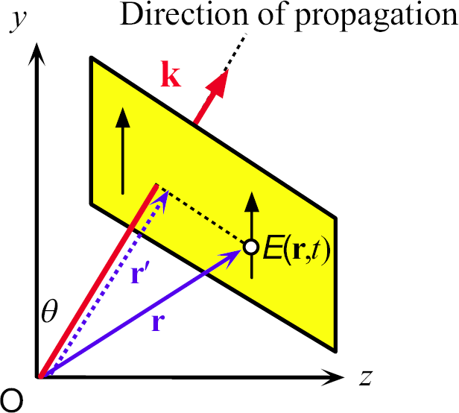
Wave Vector k
E (r,t) = E_{o}cos(ωt − k⋅r + φ_{ο})
A traveling plane EM wave along a direction k

Slide 12
Maxwell’s Wave Equation
∂² E ₊ ∂² E ₊ ∂² E _{− ε ε μ} ∂² E ₌
0
o r o
∂x² ∂y² ∂z² ∂t ²
A plane wave is a solution of Maxwell’s wave equation
E_{x} = E_{o} cos(ωt − kz + φ_{ο})
Substitute into Maxwell’s Equation to show that this is a solution.

Slide 13
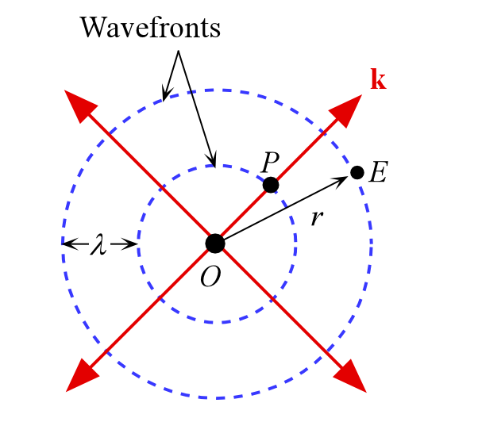
Spherical Wave
E = ^{A} cos(ωt − kr) r

Slide 14
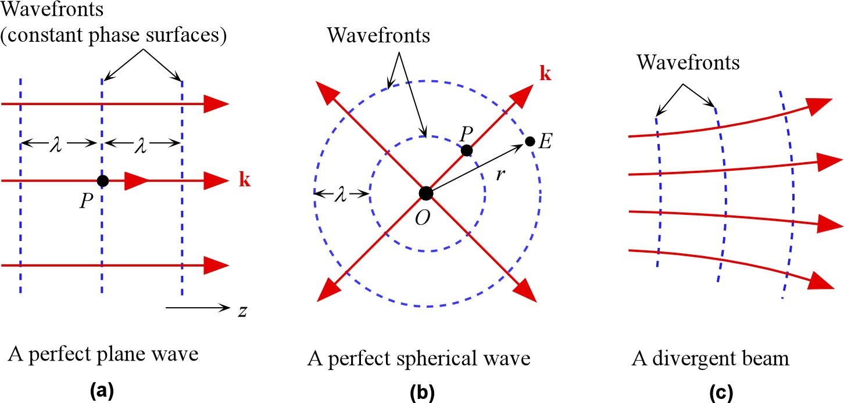
Examples of possible EM waves
Optical divergence refers to the angular separation of wave vectors on a given wavefront.

Slide 15
Refractive Index
When an EM wave is traveling in a dielectric medium, the oscillating electric field polarizes the molecules of the medium at the frequency of the wave
The stronger is the interaction between the field and the dipoles, the slower is the propagation of the wave

Slide 16
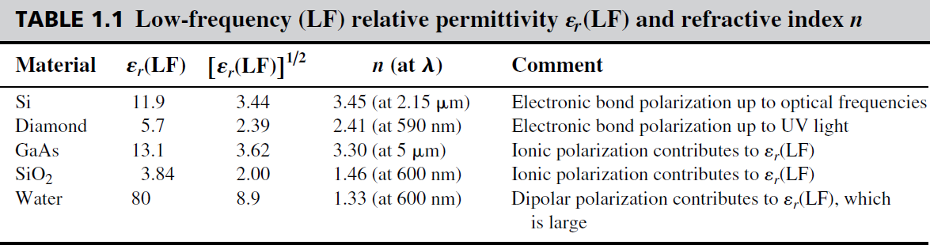
Refractive Index

Slide 17
Maxwell’s Wave Equation in an isotropic medium
∂² E ₊ ∂² E ₊ ∂² E _{− ε ε μ} ∂² E ₌
0
o r o
∂x² ∂y² ∂z² ∂t ²
A plane wave is a solution of Maxwell’s wave equation
E_{x} = E_{o} cos(ωt − kz + φ_{ο})
The phase velocity of this plane wave in the medium is given by
ω
k
1
ε_{o}ε_{r} μ_{o}
v =
=
The phase velocity in vacuum is
ω
k_{o}
1
ε_{o} μ_{o}
c =
=

Slide 18
Phase Velocity and α_{r}
The relative permittivity ε_{r} measures the ease with which the medium becomes polarized and hence it indicates the extent of interaction between the field and the induced dipoles.
For an EM wave traveling in a nonmagnetic dielectric medium of relative permittivity ε_{r}, the phase velocity v is given by
1
ν =
ε ε μ
r o o

Slide 19
Refractive Index n
1
Phase Velocity and ε_{r} ν =
ε ε μ
r o o
Refractive index n
definition
n = ^{c} = ε
v

Slide 20
Optical frequencies
Typical frequencies that are involved in optoelectronic devices are in the infrared (including far infrared), visible, and UV, and we generically refer to these frequencies as optical frequencies
Somewhat arbitrary range:
Roughly 10¹² Hz to 10¹⁶ Hz

Slide 21
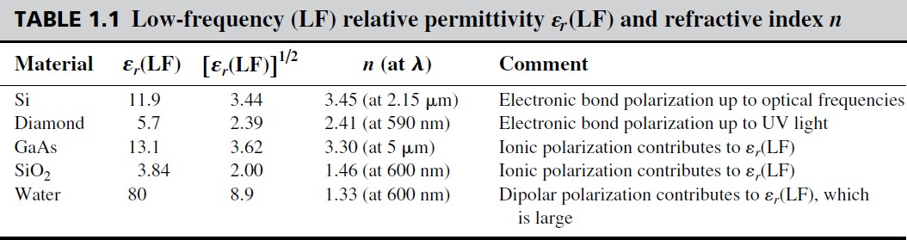
Low frequency (LF) relative permittivity ε_{r}(LF) and refractive index n.

Slide 22
Refractive Index and Propagation Constant
k_{o} Free-space propagation constant (wave vector)
k_{o} 2π/λ_{ο}
λ_{o} Free-space wavelength
k Propagation constant (vave vector) in the medium
λ Wavelength in the medium
n = ^{k} k_{o}
In noncrystalline materials such as glasses and liquids, the material structure is the same in all directions and n does not depend on the direction. The refractive index is then isotropic

Slide 23
Refractive Index and Wavelength
It is customary to drop the subscript o on k and λ
^{k}medium ^{= nk}
In free space
λ = λ /n
medium

Slide 24
Refractive Index and Isotropy
Crystals, in general, have nonisotropic, or anisotropic, properties
Typically noncrystalline solids such as glasses and liquids, and cubic crystals are optically isotropic; they possess only one refractive index for all directions

Slide 25
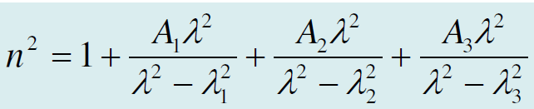
n depends on the wavelength λ
Dispersion relation: n = n(λ)
The simplest electronic polarization gives
N_{at} =Number of atoms per unit volume
Z = Number of electrons in the atom (atomic number)
λ_{o} = A “resonant frequency”
Sellmeier Equation

Slide 26
n depends on the wavelength λ
Cauchy dispersion relation
n = n(υ)
n = n₋₂(hυ)⁻² + n₀ + n₂(hυ)² + n₄(hυ)⁴

Slide 27
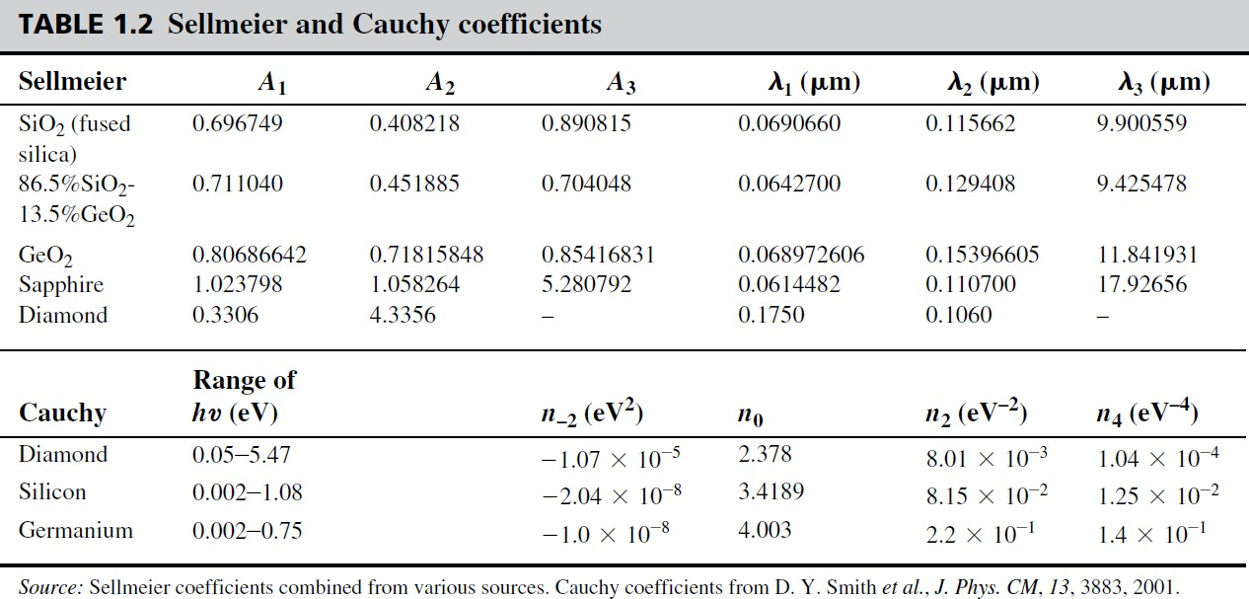
n depends on the wavelength λ

Slide 28
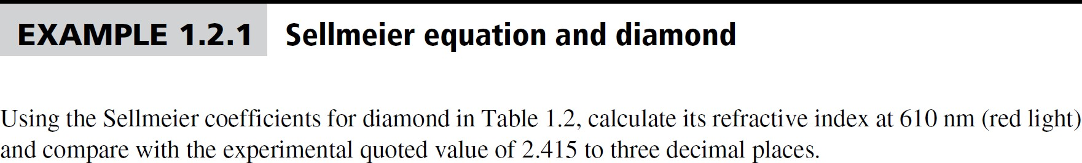
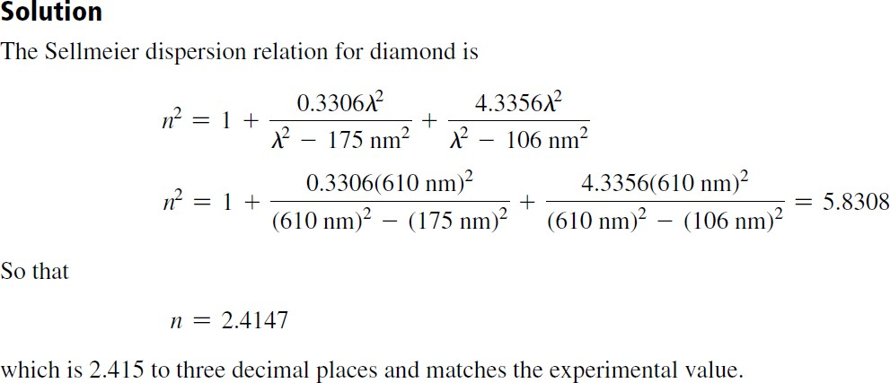

Slide 29
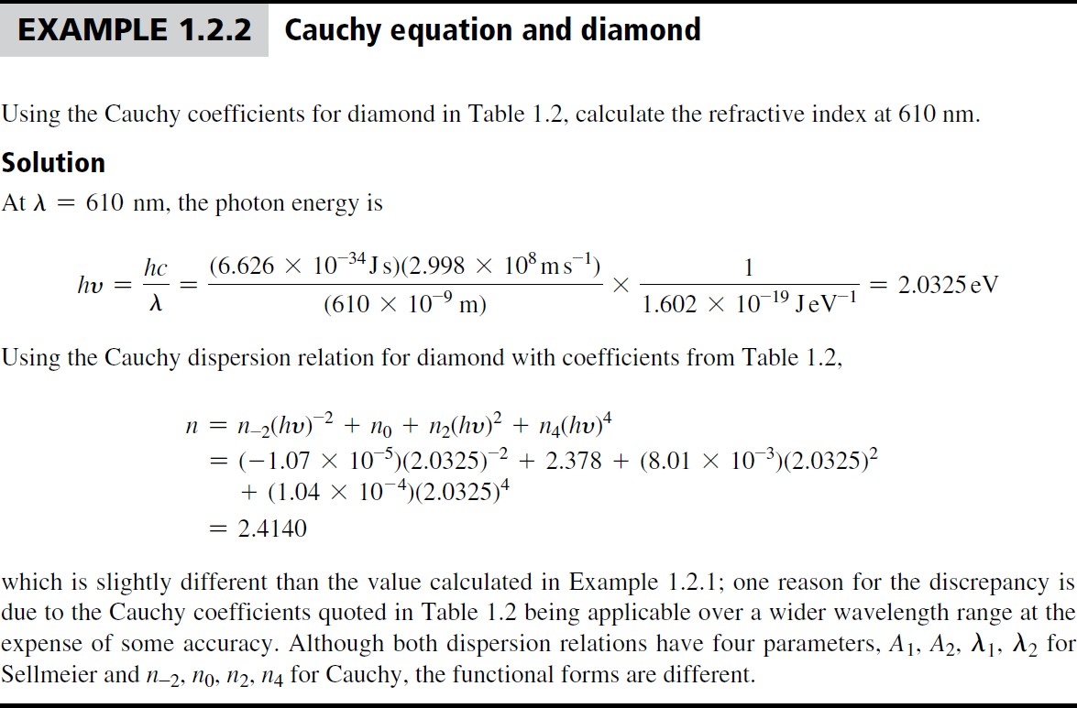

Slide 30
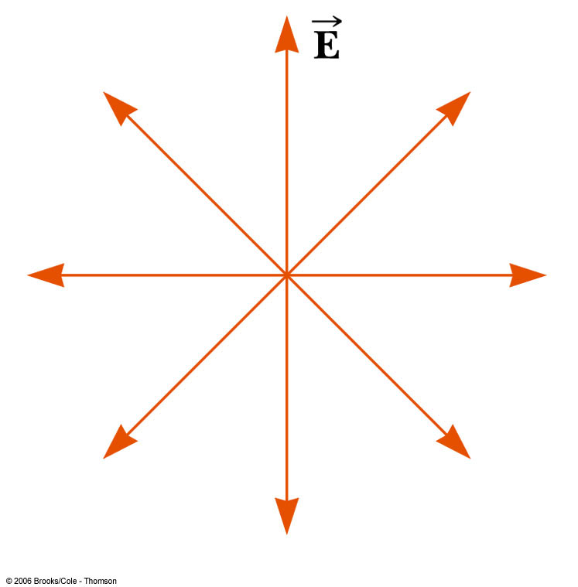
Polarization of Light Waves
Each atom produces a wave with its own orientation of
All directions of the electric field vector are equally possible and lie in a plane perpendicular to the direction of propagation
This is an unpolarized wave

Slide 31
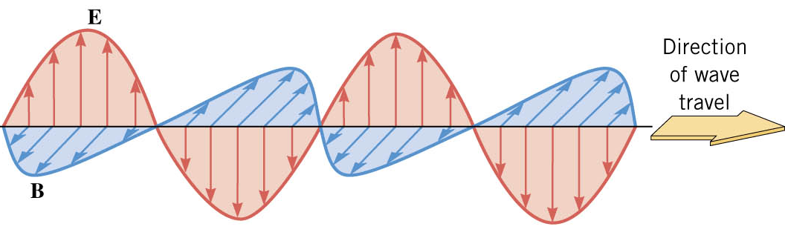
Polarization
x
z
y
Light is an electromagnetic wave with the electric and magnetic field having very specific orientations
A light wave in which the electric field always vibrates along one direction is called a linearly polarized wave
The direction of polarization is the axis along which the electric field vibrates
In the diagram above, the wave polarization is x

Slide 32
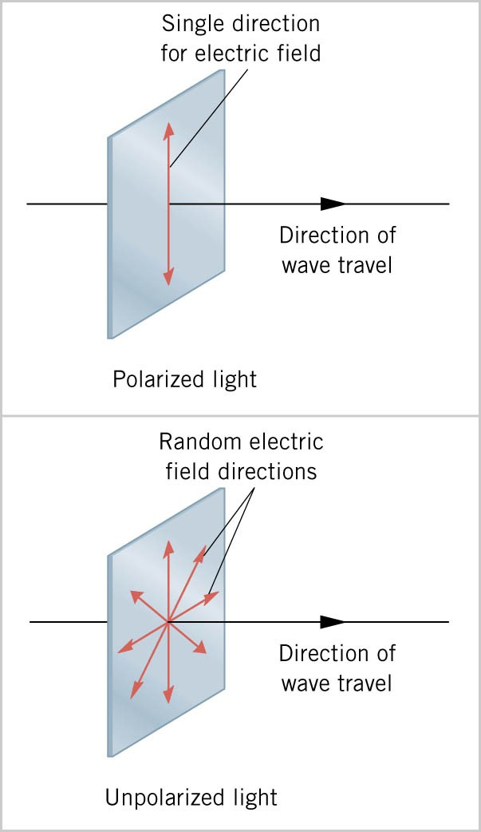
Polarization
the direction in which the electric field vibrates is the direction of polarization
with polarized light the electric field always vibrates in one direction
ordinary light is unpolarized so that the electric field is randomly oriented about the direction of travel

Slide 33
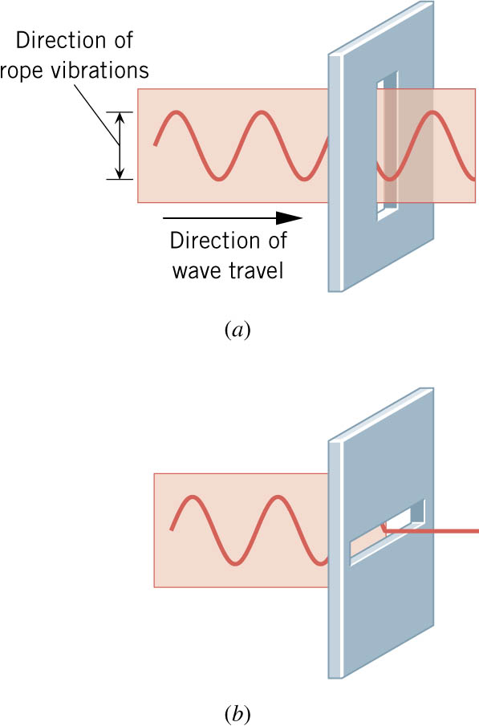
a transverse wave is linearly polarized with its vibrations always along one direction
a linearly polarized wave can pass through a slit that is parallel to the vibration direction
the wave cannot pass through a slit that is perpendicular to the vibration direction

Slide 34
Polarization
Polarization of a plane wave is the orientation of the oscillations of the E field; perpendicular to the direction of propagation
For a simple harmonic wave, the electric vector in orthogonal directions may have:
Different amplitude
Different phase
The resulting wave is
Linearly, elliptically or circularly polarized

Slide 35
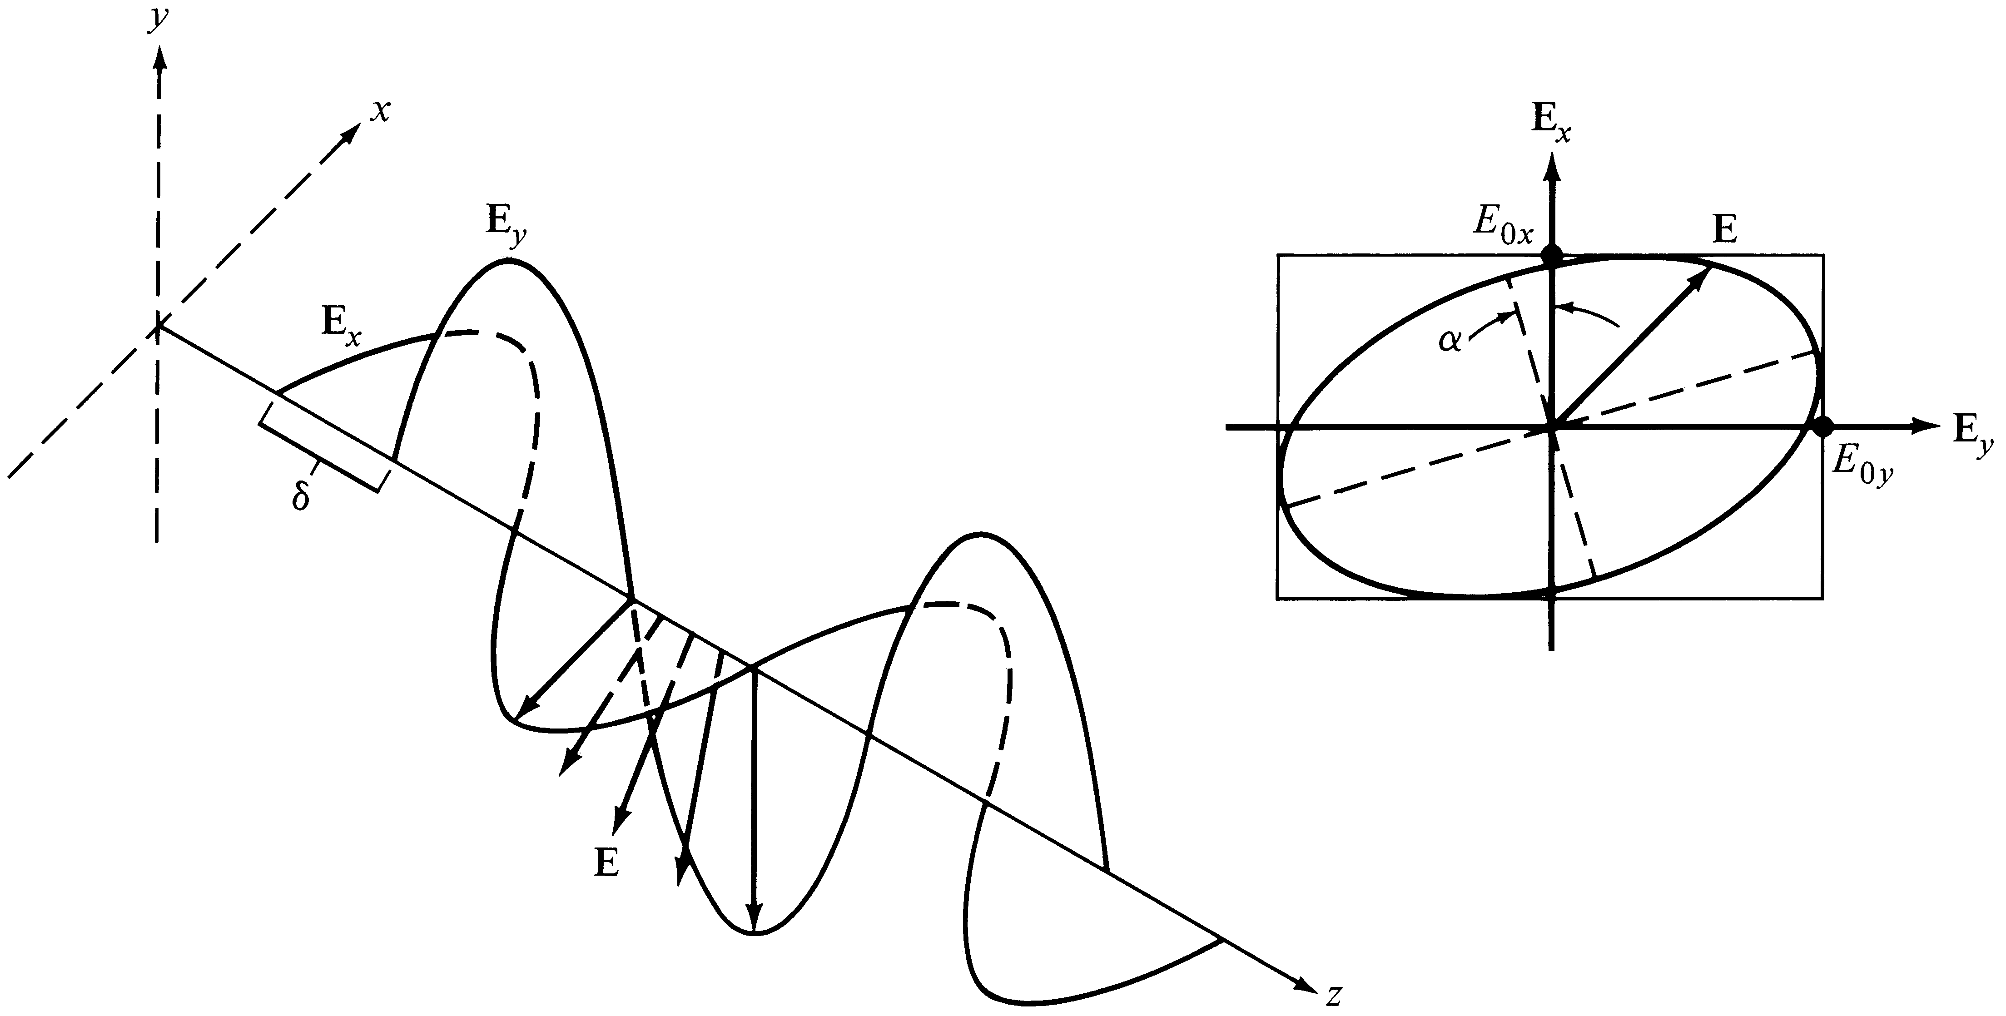
When the orthogonal components have different phase and amplitude, resulting wave is Elliptically Polarized (General Case)
Notes:
4

Slide 36
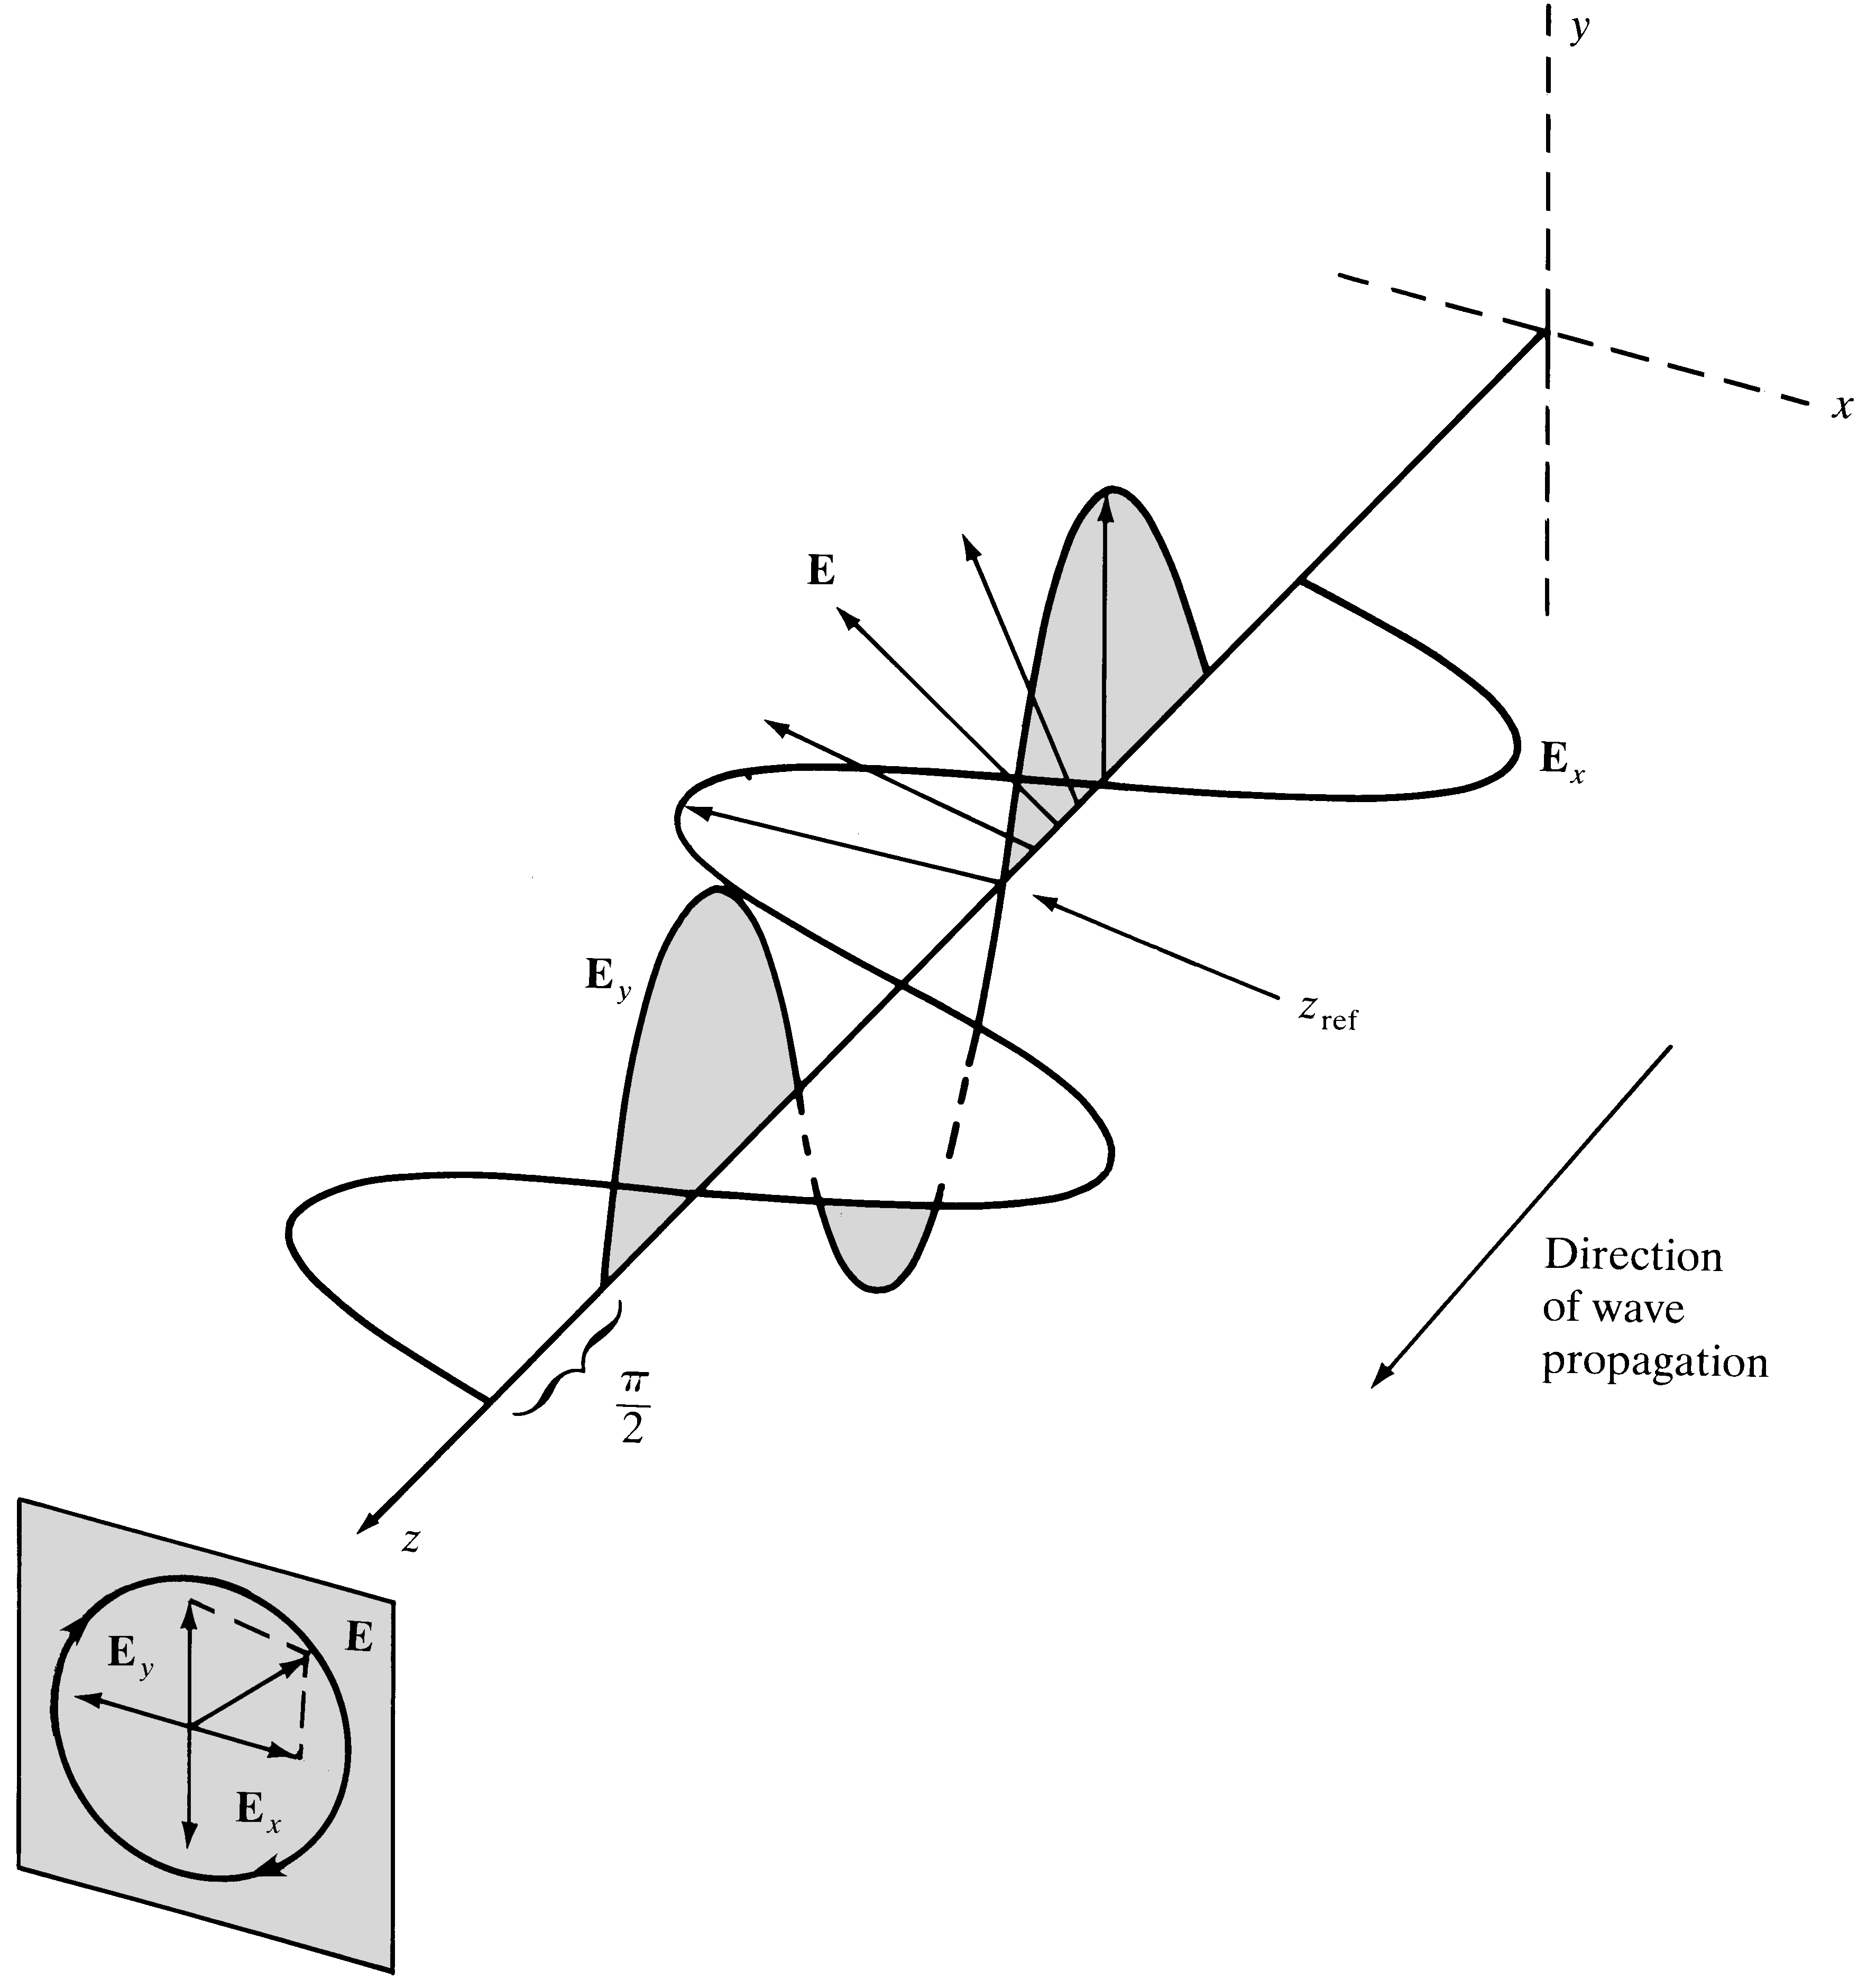
When the orthogonal components have 90º phase shift and equal amplitude, the resulting wave is Circularly Polarized (Special Case)
Notes:
5

Slide 37
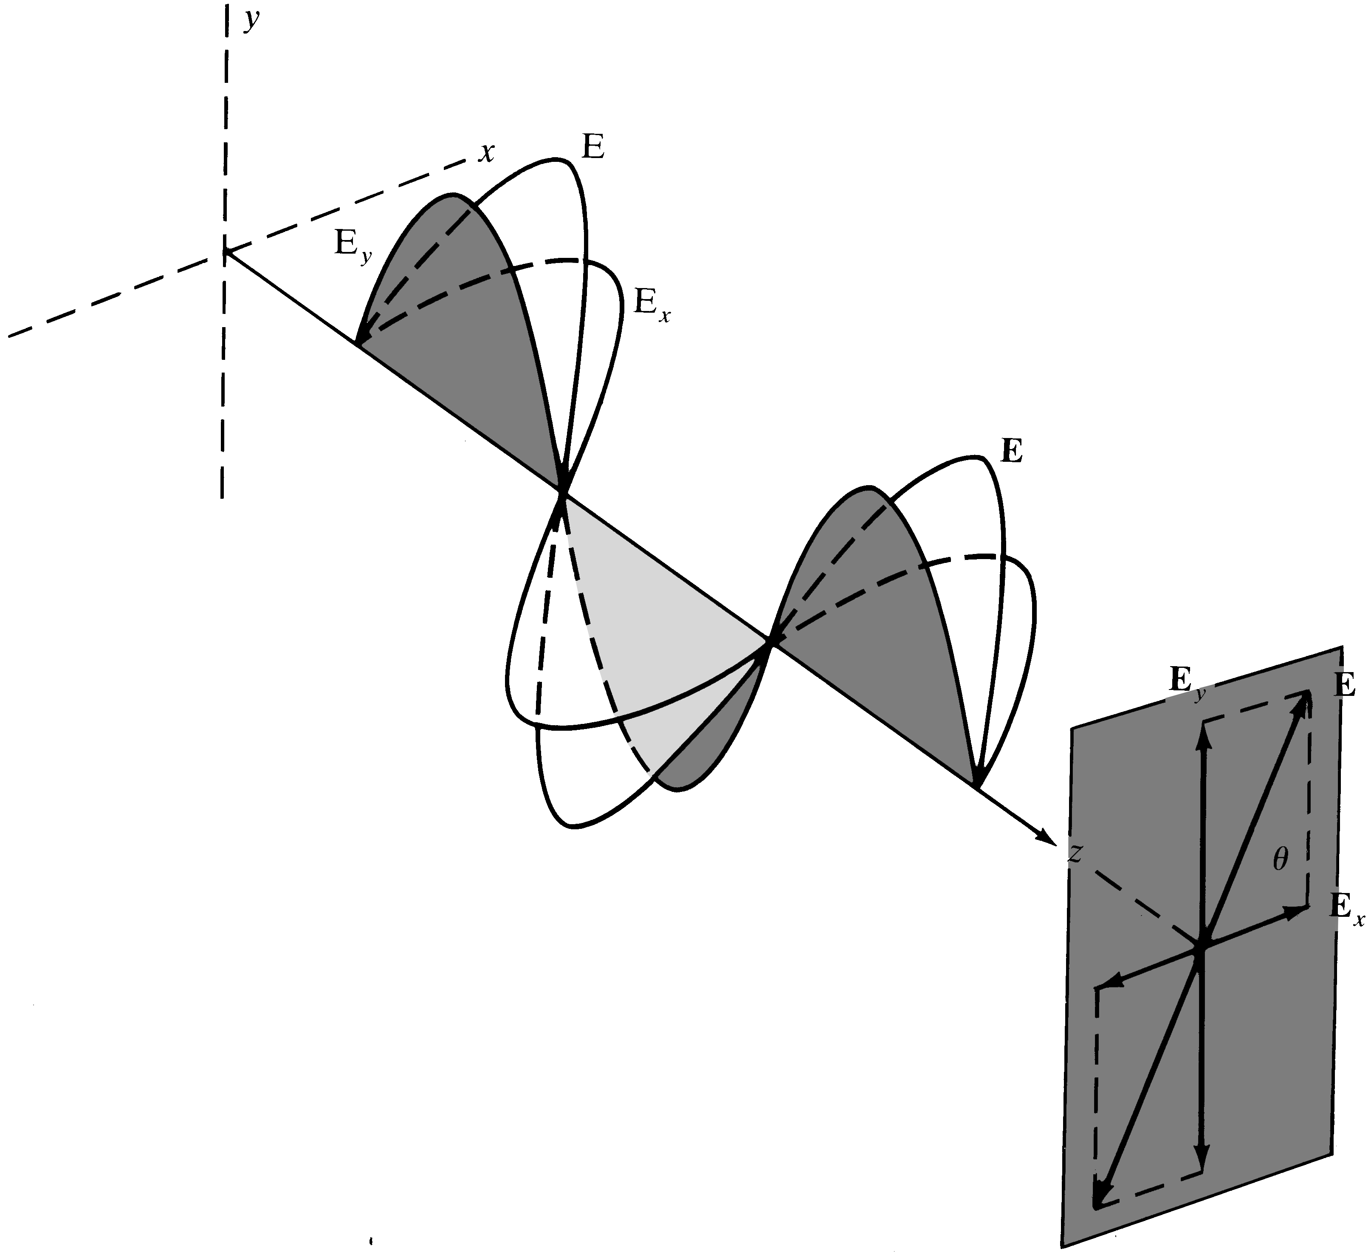
When the orthogonal components have zero phase shift, resulting wave is Linearly Polarized
More useful
Emitted by lasers
Polarization control is possible
Horizontal and vertical polarizations
Notes:
3

Slide 38
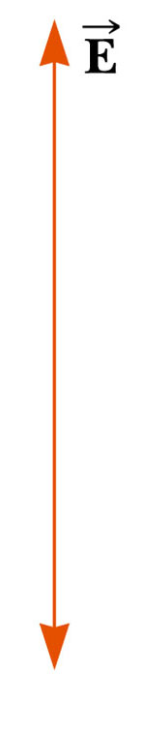
Polarization of Light, cont
A wave is said to be linearly polarized if the resultant electric field vibrates in the same direction at all times at a particular point
Polarization can be obtained from an unpolarized beam by
selective absorption
reflection

Slide 39
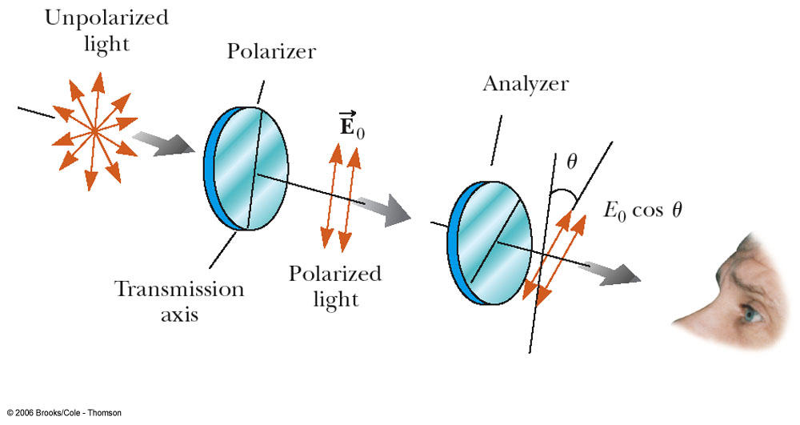
Polarization by Selective Absorption
The most common technique for polarizing light
Uses a material that transmits waves whose electric field vectors in the plane are parallel to a certain direction and absorbs waves whose electric field vectors are perpendicular to that direction

Slide 40
Selective Absorption, cont
E. H. Land discovered a material that polarizes light through selective absorption
He called the material Polaroid
The molecules readily absorb light whose electric field vector is perpendicular to their lengths and transmit light whose electric field vector is parallel to their lengths

Slide 41
Selective Absorption, final
The intensity of the polarized beam transmitted through the second polarizing sheet (the analyzer) varies as
I = I_{o} cos² θ
I_{o} is the intensity of the polarized wave incident on the analyzer
This is known as Malus’ Law and applies to any two polarizing materials whose transmission axes are at an angle of θ to each other

Slide 42
Polarization by Reflection
When an unpolarized light beam is reflected from a surface, the reflected light is
Completely polarized
Partially polarized
Unpolarized
It depends on the angle of incidence
If the angle is 0° or 90°, the reflected beam is unpolarized
For angles between this, there is some degree of polarization
For one particular angle, the beam is completely polarized

Slide 43
Polarization by Reflection, cont
The angle of incidence for which the reflected beam is completely polarized is called the polarizing angle, θ_{p}
Brewster’s Law relates the polarizing angle to the index of refraction for the material
θ_{p} may also be called Brewster’s Angle

Slide 44
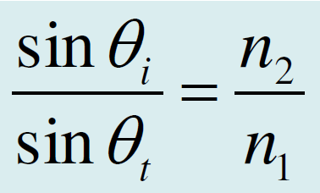
Snell's Law

Slide 45
Derivation of Snell’s Law
A light wave traveling in a medium with a greater refractive index (n₁ > n₂) suffers reflection and refraction at the boundary. (λ_{t} is slightly longer than λ.)

Slide 46
Snell's Law
We can use constructive interference to show that there can only be one reflected wave which occurs at an angle equal to the incidence angle. The two waves along A_{i} and B_{i} are in phase.
When these waves are reflected to become waves A_{r} and B_{r} then they must still be in phase, otherwise they will interfere destructively and destroy each other. The only way the two waves can stay in phase is if θ_{r} = θ_{i}. All other angles lead to the waves A_{r} and B_{r} being out of phase and interfering destructively.

Slide 47
Unless the two waves at A′ and B′ still have the same phase, there will be no transmitted wave. A′ and B′ points on the front are only in phase for one particular transmitted angle, θt.
It takes time t for the phase at B on wave Bi to reach B′
BB′ = v1t = ct/n1
During this time t, the phase A has progressed to A′
AA′ = v2t = ct/n2
A′ and B′ belong to the same front just like A and B so that AB is perpendicular to ki in medium 1 and A′B′ is perpendicular to kt in medium 2. From geometrical considerations,
AB′ = BB′/sin θi and AB′ = AA′/sin θt

Slide 48
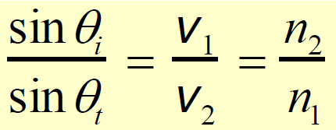
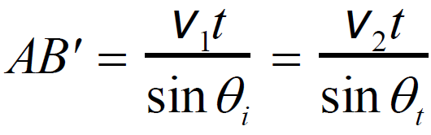
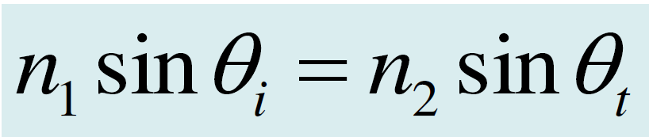
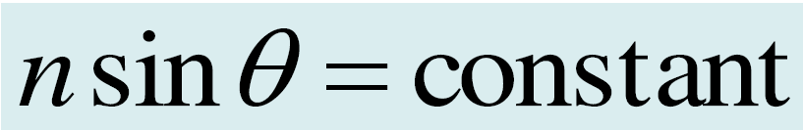
This is Snell's law which relates the angles of incidence and refraction to the refractive indices of the media.

Slide 49
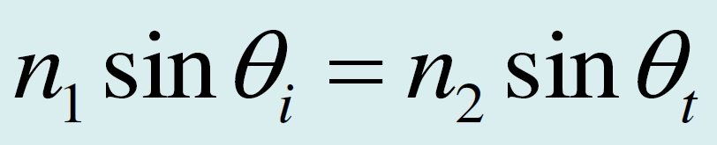
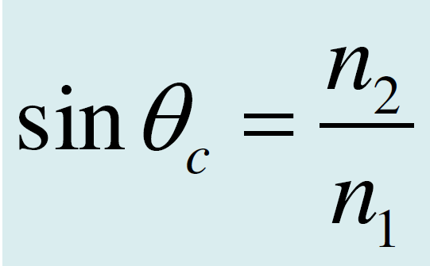
Critical Angle
When n1 > n2 then obviously the transmitted angle is greater than the incidence angle as apparent in the figure. When the refraction angle θt reaches 90°, the incidence angle is called the critical angle θc which is given by

Slide 50
Total Internal Reflection (TIR)
When the incidence angle θi exceeds θc then there is no transmitted wave but only a reflected wave.
The latter phenomenon is called total internal reflection (TIR).
TIR phenomenon that leads to the propagation of waves in a dielectric medium surrounded by a medium of smaller refractive index as in optical waveguides, e.g. optical fibers.
Although Snell's law for θi > θc shows that sin θt > 1 and hence θt is an "imaginary" angle of refraction, there is however an attenuated wave called the evanescent wave.

Slide 51
Total Internal Reflection (TIR)
Light wave traveling in a more dense medium strikes a less dense medium.
Depending on the incidence angle with respect to θc, which is determined by the ratio of the refractive indices, the wave may be transmitted (refracted) or reflected.
(a) θi < θc (b) θi = θc (c) θi > θc and total internal reflection (TIR).

Slide 52
Prisms

Slide 53
Light travels by total internal reflection in optical fibers
An optical fiber link for transmitting digital information in communications. The fiber core
has a higher refractive index so that the light travels along the fiber inside the fiber core
by total internal reflection at the core-cladding interface.

Slide 54
A small hole is made in a plastic bottle full of water to generate a water jet. When the hole is illuminated with a laser beam (from a green laser pointer), the light is guided by total internal reflections along the jet to the tray. The light guiding by a water jet was first demonstrated by Jean-Daniel Colladan, a Swiss scientist (Water with air bubbles was used to increase the visibility of light. Air bubbles scatter light.)

Slide 55
Superposition and Interference of waves

Slide 56
Interference
E1 = Eo1sin(ωt – kr1 – φ1) and E2 = Eo2sin(ωt – kr2 – φ2)
Interference results in E = E1 + E2

Slide 57
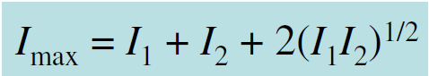
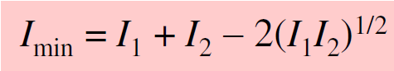
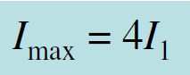
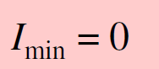
Interference
Resultant intensity I is
I = I1 + I2 + 2(I1I2)^{1/2}cosδ
δ = k(r2 – r1) + ( φ2 – φ 1)
Phase difference due to optical path difference
Constructive interference
Destructive interference
If the interfering beams have equal irradiances, then

Slide 58
Interference between coherent waves
Resultant intensity I is
I = I1 + I2 + 2(I1I2)^{1/2}cosδ
δ = k(r2 – r1) + ( φ2 – φ1)
Interference between incoherent waves
I = I1 + I2

Slide 59
Interference between coherent waves
Resultant intensity I is
I = I1 + I2 + 2(I1I2)^{1/2}cosδ
δ = k(r2 – r1) + ( φ2 – φ1)

Slide 60
Diffraction Principles- Fraunhofer diffraction,
Diffraction Grating

Slide 61
Diffraction
A light beam incident on a small circular aperture becomes diffracted and its light intensity pattern after passing through the aperture is a diffraction pattern with circular bright rings (called Airy rings).
If the screen is far away from the aperture, this would be a Fraunhofer diffraction pattern.

Slide 62
Diffraction from a Circular Aperture
A light beam incident on a small circular aperture becomes diffracted and its light intensity pattern after passing through the aperture is a diffraction pattern with circular bright rings (called Airy rings).
If the screen is far away from the aperture, this would be a Fraunhofer diffraction pattern.

Slide 63
Diffraction
Huygens-Fresnel principle
Every unobstructed point of a wave front, at a given instant in time, serves as a source of spherical secondary waves (with the same frequency as that of the primary wave). The amplitude of the optical field at any point beyond is the superposition of all these wavelets (considering their amplitudes and relative phases)

Slide 64
Diffraction
Huygens-Fresnel principle states that each point in the aperture becomes a source of secondary waves (spherical waves). The spherical wave fronts are separated by λ. The new wavefront is the envelope of the all these spherical wavefronts.
(b) Another possible wavefront occurs at an angle q to the z-direction which is a diffracted wave.

Slide 65
Diffraction from a Single Slit
The aperture has a finite width a along y, but it is very long along x so that it is a one-dimensional slit. The aperture is divided into N number of point sources each occupying δy with amplitude proportional to δy since the slit is excited by a plane electromagnetic wave.
(b) The intensity distribution in the received light at the screen far away from the aperture: the diffraction pattern.
Note that the slit is very long along x and there is no diffraction along this dimension.
(c) Diffraction pattern obtained by using a laser beam from a pointer incident on a single slit.

Slide 66
Diffraction from a Single Slit

Slide 67
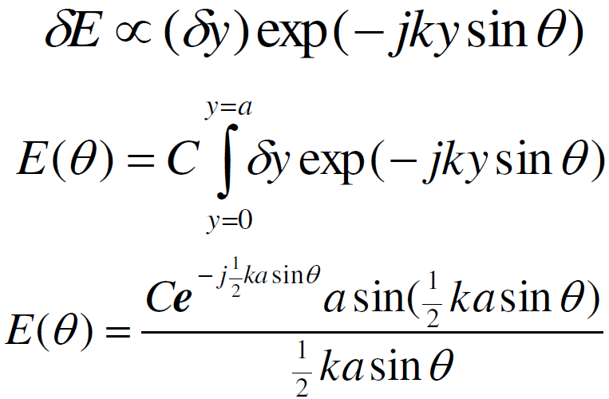
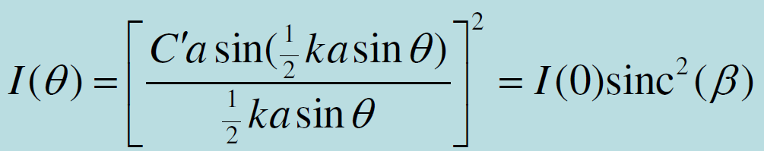
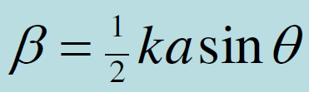
Diffraction from a Single Slit

Slide 68
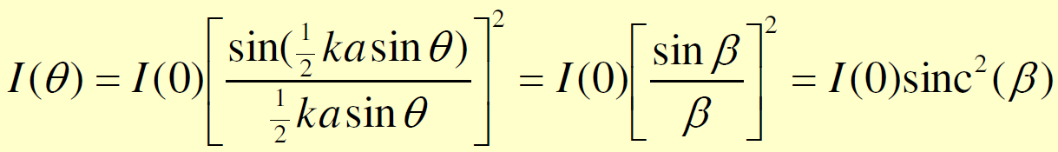
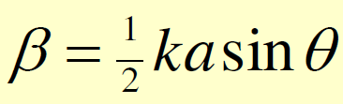
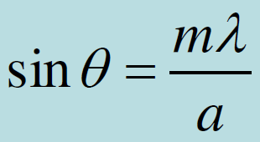
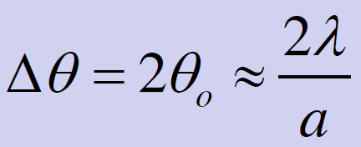
Diffraction from a Single Slit
Zero intensity when I(θ) = 0
Divergence

Slide 69
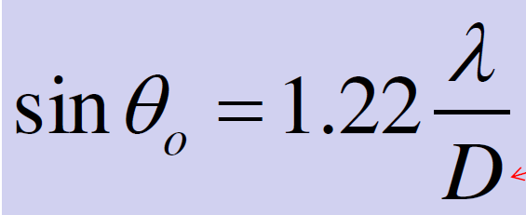
Diffraction from a Circular Aperture
Diameter of aperture

Slide 70
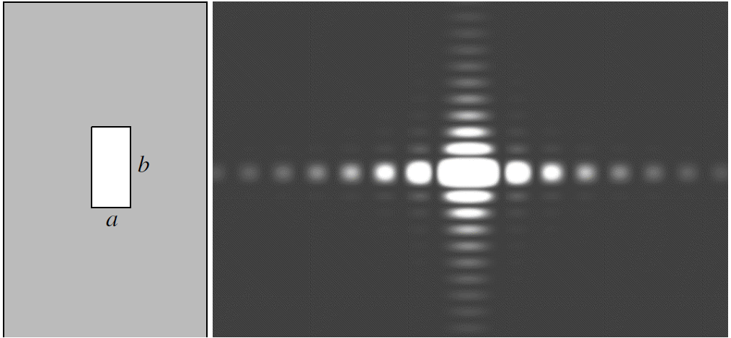
Diffraction from a Rectangular Aperture
The rectangular aperture of dimensions a × b on the left gives the diffraction pattern on the right. (b is twice a)

Slide 71
Diffraction from a Square Aperture
Diffraction pattern far away from a square aperture. The image has been overexposed to capture the faint side lobes

Slide 72
Diffraction from a Circular Aperture
Diffraction pattern far away from a circular aperture. The image has been overexposed to capture the faint outer rings

Slide 73
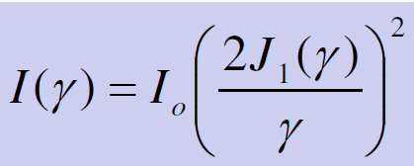
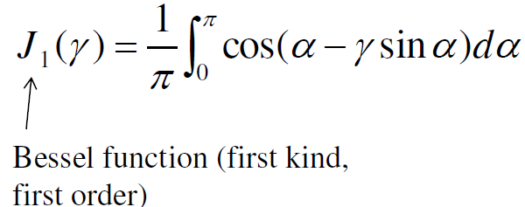
Diffraction from a Circular Aperture
Intensity distribution
γ = (1/2)kDsinθ
k = 2π/λ

Slide 74
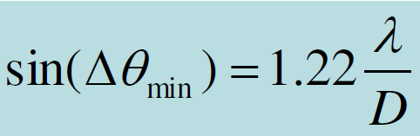
Rayleigh Criterion
Resolution of imaging systems is limited by diffraction effects. As points S1 and S2 get closer, eventually the Airy patterns overlap so much that the resolution is lost. The Rayleigh criterion allows the minimum angular separation two of the point sources be determined.

Slide 75
Rayleigh Criterion
Image of two point sources captured through a small circular aperture. (a) The two points are fully resolved since the diffraction patterns of the two sources are sufficiently
separated. (b) The two images near the Rayleigh limit of resolution. (c) The first dark ring through the center of the bright Airy disk of the other pattern. (Approximate.)

Slide 76
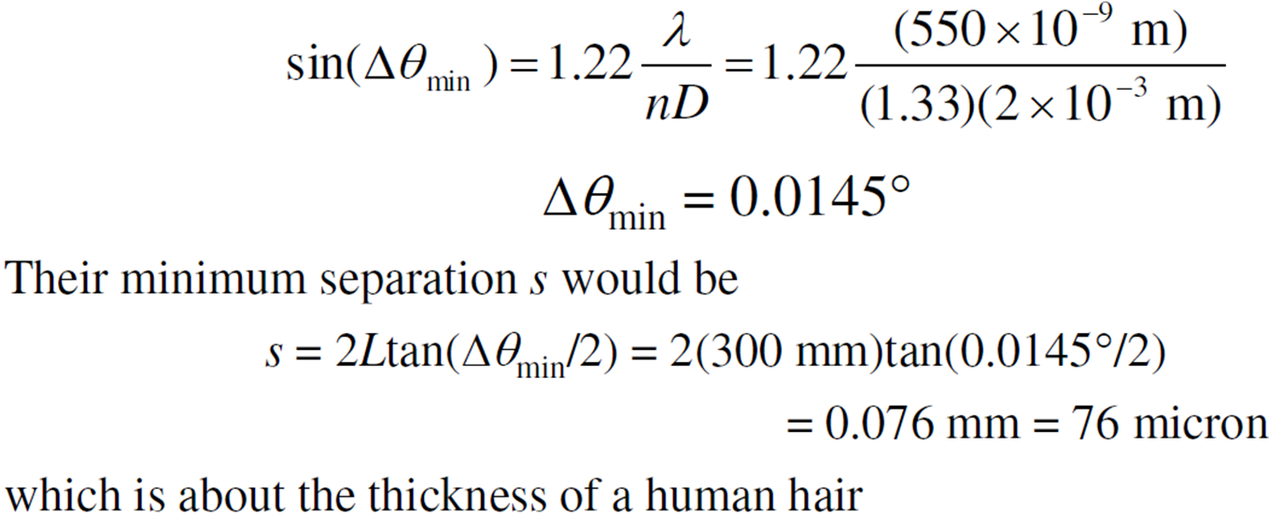
Resolution of the Human Eye
The human eye has a pupil diameter of about 2 mm. What would be the minimum angular separation of two points under a green light of 550 nm and their minimum separation if the two objects are 30 cm from the eye?
The image will be diffraction pattern in the eye, and is a result of waves in this medium.
If the refractive index n ≈ 1.33 (water) in the eye, then

Slide 77
Experimental Diffraction Patterns
Diffraction from a circular aperture with a diameter of 30 μm
Green laser pointer used at a wavelength of 532 nm

Slide 78
Experimental Diffraction Patterns
Crossed slits 200 x 100 μm
Green laser pointer used at a wavelength of 532 nm

Slide 79
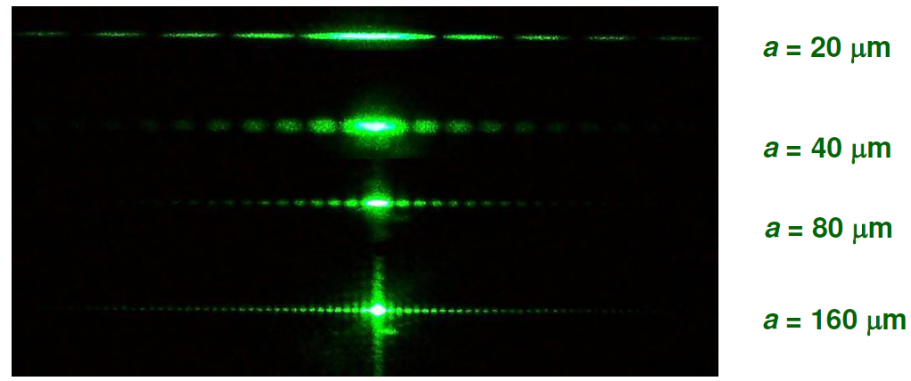
Experimental Diffraction Patterns
Single slit with a width a
Green laser pointer used at a wavelength of 532 nm

Slide 80
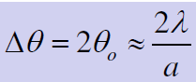
Experimental Diffraction Patterns
Single slit with a width 100 μm
Blue = 402 nm
Green = 532 nm
Answer
Red = 670 nm
Why does the central bright lobe get larger with increasing wavelength?

Slide 81
Diffraction Grating
A diffraction grating with N slits in an opaque screen. Slit periodicity is d and slit width is a; a<< d.
(b) The far-field diffracted light pattern. There are distinct, that is diffracted, beams in certain directions
(c) Diffraction pattern obtained by shining a beam from a red laser pointer onto a diffraction grating. The finite size of the laser beam results in the dot pattern. (The wavelength was 670 nm, red, and the grating has 2000 lines per inch.)

Slide 82
Diffraction Grating
Bragg diffraction condition
Normal incidence
dsinθ = mλ
; m = 0, ±1, ±2, …
William Lawrence Bragg (1890-1971), Australian-born British physicist, won the Nobel prize with his father William Henry Bragg for his "famous equation" when he was only 25 years old

Slide 83
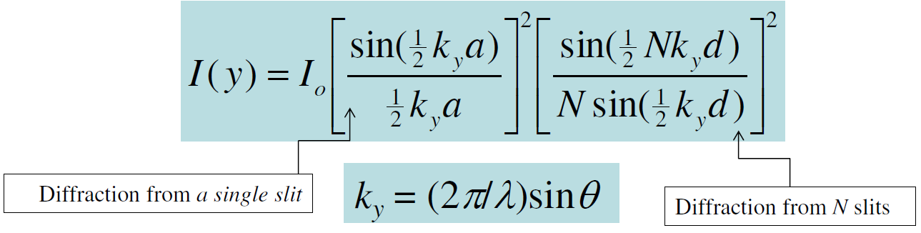
Diffraction Gratings
Bragg diffraction condition
Normal incidence
dsinθ = mλ
; m = 0, ±1, ±2, …
Oblique incidence
d(sinθm − sin θi) = mλ ; m = 0, ±1, ±2,

Slide 84
Diffraction Gratings
Ruled periodic parallel scratches on a glass serve as a transmission grating. (The glass plate is assumed to be very thin.)
(b) A reflection grating. An incident light beam results in various "diffracted" beams. The zero-order diffracted beam is the normal reflected beam with an angle of reflection equal to the angle of incidence.

Slide 85
A blazed grating. Triangular grooves have been cut into the surface with a periodicity d. The side of a triangular groove make an angle γ to the plane of the diffraction angle. For normal incidence, the angle of diffraction must be 2γ to place the specular reflection on the diffracted beam.
(b) When the incident beam is not normal, the specular reflection will coincides with the diffracted beam,
when (γ + θ i) + γ = θm

Slide 86
Example: A reflection grating
Consider a reflection grating with a period d that is 10 μm. Find the diffracted beams if a collimated light wave of wavelength 1550 nm is incident on the grating at an angle of 45° to its normal. What should be the blazing angle γ if we were to use the blazed grating with the same periodicity? What happens to the diffracted beams if the periodicity is reduced to 2 μm?
Solution:
Put, m = 0 to find the zero-order diffraction, θ0 = 45°, as expected.
The general Bragg diffraction condition is
d(sinθm − sin θi) = mλ.
∴ (10 μm)(sinθm − sin(45°) = (+1)(1.55 μm)
∴ (10 μm)(sinθm − sin(45°) = (−1)(1.55 μm)
Solving these two equations, we find
θm = 59.6° for m = 1 and θm = 33.5° for m = −1

Slide 87
Example: A reflection grating
The secular reflection from the grooved surface
coincides with the mth order diffraction when 2γ = θm − θi
∴ γ = (1/2)(θm − θi) = (1/2)(59.6° – 45°) = 7.3°
Suppose that we reduce d to 2 μm
Recalculating the above we find
θm = −3.9° for m = −1 and imaginary for m = +1.
Further, for m = −2, there is a second order
diffraction beam at θm = −57.4°.
If we increase the angle of incidence, for example, θi = 85° on the first grating, the diffraction angle for m = −1 increases from 33.5° to 57.2° and the other diffraction peak (m = 1) disappears

Slide 88
Experiments with Diffraction Gratings
Diffraction grating
(2000 lines/inch)
Blue = 402 nm
Green = 532 nm
Red = 670 nm
Why do the diffraction spots become further separated as you increase the wavelength?

Slide 89
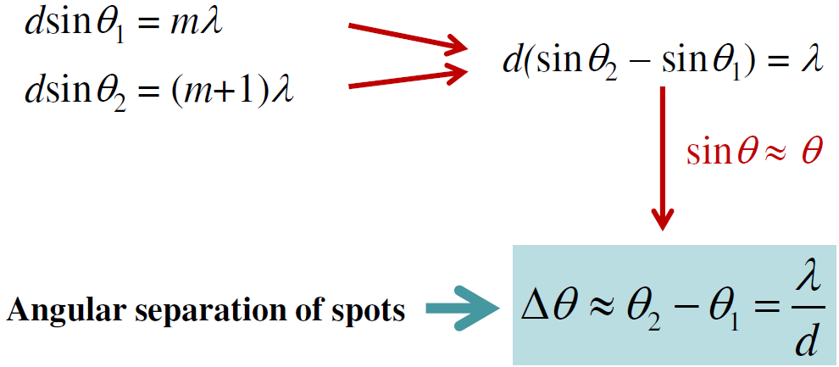
ANSWER

Slide 90
We can separate wavelengths by using a diffraction grating
Useful in Wavelength Division Multiplexing

Slide 91
Example on Wavelength Separation by Diffraction
A transmission diffraction grating has a periodicity of 3 μm. The angle of incidence is 30° with respect to the normal to the diffraction grating. What is the angular separation of the two wavelength component s at 1550 nm and 1540 nm, separated by 10 nm?
d(sinθm − sin θi) = mλ

Slide 92
Example on Wavelength Separation
θi = 45°. Periodicity = d = 3 μm
d(sinθm − sin θi) = mλ.
d = 3 μm, λ = 1.550 μm, θi = 45°, and calculate the diffraction angle θm for m = −1
(3 μm)[sin θ1 − sin(45°)] = (− 1)(1.550 μm)
∴ θ1 = 10.978°
A λ′ = 1.540 μm, examining the same order, m = − 1, we find θ1′ = 11.173°
∴ Δθ1 = 11.173° − 10.978° = 0.20°
Note, m = 1 gives a complex angle and should be neglected.

Slide 93
Semiconductors
A semiconductor is a solid material that has electrical conductivity in between a conductor and an insulator.
Semiconductors can be used as optical detectors, sources (light-emitting diodes and lasers), amplifiers, waveguides, modulators, sensors, and nonlinear optical elements.

Slide 94
Energy bands in semiconductors
The solution of the Schrödinger equation for the electron energy in the periodic potential created by the atoms in a crystal lattice, results in a splitting of the atomic energy levels and the formation of energy bands.
E2’
Conduction band
E21
E1’
Valence band
ATOM
SOLID

Slide 95

Energy bands in semiconductors
Each band contains a large number of finely separated discrete energy levels that can be approximated as a continuum.
The valence and conduction bands are separated by a “forbidden” energy gap of width Eg bandgap energy
Unfilled bands
Conduction band
Bandgap
E
Filled bands
Valence band

Slide 96
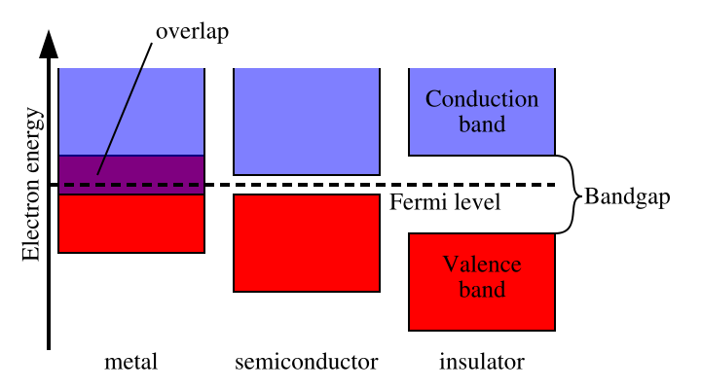
Energy bands in semiconductors
Materials with a large energy gap (>3eV) are insulators, those for which the gap is small or nonexistent are conductors, semiconductors have gaps roughly in the range 0.1 to 3 eV

Slide 97
ev
ev
Si
GaAs
Conduction band
Conduction band
5
5
Eg
Eg
1.1ev
0
1.42ev
0
Energy
Energy
Valence band
Valence band
-5
-5
-10
-10
-15
-15
(a)
(b)
Figure 15.1-1 Energy bands: (a) in Si, and (b) in GaAs

Slide 98
Electrons and holes
In the absence of thermal excitations, the valence band is completely filled and the conduction band is completely empty. Thus, the material cannot conduct electricity.
As the temperature increases, some electrons will be thermally exited into the empty conduction band, result in the creation of a free electron in the conduction band and a free hole in the valence band.

Slide 99
Electrons and holes
Conduction band
Electron energy E
Electron
Hole
Bandgap energy Eg
Valence band
Electrons in the conduction band and holes in the valence band at T>0.

Slide 100
Energy-momentum relations
p is the magnitude of the momentum
k is the magnitude of the wave vector associated with the electron’s wave function
m₀ is the electron mass

Slide 101
E
Eg=1.1ev
K
Si
[111]
[100]
E
Eg=1.42ev
K
GaAs
[111]
[100]
Figure 15.1-3 Cross section of the E-K function for Si and GaAs along the crystal directions [111] and [100].
The energy of an electron in the conduction band depends not only on the magnitude of its momentum, but also on the direction in which it is traveling in the crystal

Slide 102
Effective mass
Near the bottom of the conduction band, the E-k relation may be approximated by the parabola
E_{c},E_{v}: the energy at the bottom of the conduction band and at the top of the valence band
m_{c},m_{v}: effective mass of the electron in the conduction band and the hole in the valence band
The effective mass depends on the crystal orientation and the particular band under consideration

Slide 103
Effective mass
Typical ratios of the average effective masses to the mass of the free electron mass
 | m_{c}/m₀ | m_{v}/m₀
Si | 0.33 | 0.5
GaAs | 0.07 | 0.5

Slide 104
Direct- and indirect-gap semiconductors
E
Eg=1.1ev
K
Si
[111]
[100]
E
Eg=1.42ev
K
GaAs
[111]
[100]
Figure 15.1-4 Approximating the E-K diagram at the bottom of the conduction band and at the top of the valence band of Si and GaAs by parabols.
The direct-gap semiconductors such as GaAs are efficient photon emitters, while the indirect-gap counterparts are not.

Slide 105
Semiconducting materials

Slide 106
Semiconducting materials
Si: widely used for making photon detectors but not useful for fabricating photon emitters due to its indirect bandgap.
GaAs, InP GaN etc.: used for making photon detectors and sources.
Ternary and quaternary semiconductors:
Al_{x}Ga_{1-x}As, In_{x}Ga_{1-x}As_{y}P_{1-y} etc.
tunable bandgap energy with variation of x and y.

Slide 107

Semiconducting materials
Al_{x}Ga_{1-x}As is lattice matched to GaAs, means it can be grown on the GaAs without introducing strains.
Solid and dashed curves represent direct-gap and indirect-gap compositions respectively.
We can see that a material may have direct bandgap for one mixing ratio x and an indirect bandgap for a different x.

Slide 108
Doped semiconductors
Dopants: alter the concentration of mobile charge carriers by many orders of magnitude.
n-type: predominance of mobile electrons
p-type: predominance of holes

Slide 109
INTERACTIONS OF PHOTONS WITH CHARGE CARRIERS (ELECTRONS AND HOLES)

Slide 110
Mechanisms leading to absorption and emission of photons in a semiconductor:
Band-to-Band (Inter-band) Transitions.
Impurity-to-Band Transitions.
Free-Carrier (Intraband) Transitions
Phonon Transitions
Excitonic Transitions.

Slide 111

Examples of absorption and emission of photons in a semiconductor. (a) Band-to-band transitions in GaAs can result in the absorption or emission of photons of wavelength . (b) The absorption of a photon of wavelength results in a valence-band to acceptor-level transition in Hg-doped Ge (Ge:Hg). (c) A free-carrier transition within the conduction band.

Slide 112
Absorption coefficient for some semiconductor materials

Slide 113


Absorption coefficient for some semiconductor materials

Slide 114
For photon energies greater than the bandgap energy E_{g}, the absorption is dominated by band-to-band transitions
Absorption edge:
The spectral region where the material changes from being relatively transparent to strongly absorbing
Direct-gap semiconductors have a more abrupt absorption edge than indirect-gap materials

Slide 115
Band-to-Band Absorption and Emission
Bandgap Wavelength:
The quantity λ_{g} is also called the cutoff wavelength.

Slide 116

Absorption and Emission
The absorption of a photon results in the generation of an electron-hole pair. This process is used in the photodetection of light.
(b) The recombination of an electron-hole pair results in the spontaneous emission of a photon. Light-emitting diodes (LEDs) operate on this basis.
(c) Electron-hole recombination can be stimulated by a photon. The result is the induced emission of an identical photon. This is the underlying process responsible for the operation of semiconductor injection lasers.

Slide 117
Conditions for Absorption and Emission
Conservation of Energy
Conservation of Momentum

Slide 118
Conditions for Absorption and Emission
Energies and Momenta of the Electron and Hole with Which a Photon Interacts

Slide 119
Optical Joint Density of States
The density of states with which a photon of energy interacts under conditions of energy and momentum conservation in a direct-gap semiconductor is determined by:
And illustrated as follow:
The density of states with which a photon of energy interacts increases with in accordance with a square-root law

Slide 120
Photon Emission Is Unlikely in an Indirect-Gap Semiconductor ！
Photon emission in an indirect-gap semiconductor
The recombination of an electron near the bottom of the conduction band with a hole near the top of the valence band requires the exchange of energy and momentum. The energy may be carried off by a photon, but one or more phonons are required to conserve momentum. This type of multiparticle interaction is unlikely.

Slide 121
Photon Absorption is Not Unlikely in an Indirect-Gap Semiconductor！
Photon absorption in an indirect-gap semiconductor
The photon generates an excited electron and a hole by a vertical transition; the carriers then undergo fast transitions to the bottom of the conduction band and top of the valence band, respectively, releasing their energy in the form of phonons. Since the process is sequential it is not unlikely.

Slide 122
Rates of Absorption and Emission
The probability densities of a photon of energy hν being emitted or absorbed by a semiconductor material in a direct band-to-band transition are mainly determined by three factors:
Occupancy probabilities
Transition probabilities
Density of states

Slide 123

Energy band diagrams
In the atoms, the larger the radius, the higher the electron potential energy
Hence, electron position can be described either by radius or by its potential energy
In the semiconductor crystal: the atom orbits OVERLAP; radius-based description becomes impractical. Energy-based description works well:
The highest orbit filled with electrons becomes the VALENCE BAND
The higher orbit (nearly empty) becomes the CONDUCTION BAND
E
Single atom
Crystal
Excited electrons cannot move
Excited electrons can move (free electrons)

Slide 124

Energy band diagrams
Free electron
^{free electrons} Conductance energy band
Hole
Valence energy band
holes
Bandgap (or “forbidden energy”)

Slide 125
Optical processes in semiconductors:
radiation and absorption
Related electrical processes:
electron - hole pair generation and recombination

Slide 126



Absorption Related electrical process:
Electron - Hole pair generation
The photon with the energy exceeding the bandgap energy of semiconductor can be absorbed.
The photon disappears; the photon energy excites the electron from the valence band into the conduction band.
As a result, one e-h pair is being created
Photon absorption
E = h ν = Ε_{g}

Slide 127

Radiation related electrical process: Electron - Hole Pair Recombination
When the excited electron meets the hole in the valence band, it may occupy that place. As a result the e-h pair disappear; this process is called recombination.
During recombination, the electron energy is released as a photon with the energy closed to the bandgap energy of the semiconductor.
Photon emission
E = h ν = Ε_{g}

Slide 128

Electron and hole concentrations under illumination
We define n₀ and p₀ as the electron and hole concentrations in the absence of illumination (“dark” concentrations).
Δn and Δp are the additional concentrations generated by light.
Note that in the equilibrium for ANY semiconductor,
n×p = n_{i} ²
Under illumination:
n×p ≈ (Δn+n₀) × (Δn+ p₀) > n_{i}²

Slide 129
Generation rate
When the semiconductor is under CONSTANT illumination, the photons are being absorbed at a constant rate; absorbed photons GENERATE electron- hole pairs
Therefore the concentration of e-h pairs MUST linearly increase with the time.
The GENERATION RATE,
G, is the number of electron-hole pair generated per unit time:
Δn = Δp = G × t;
How does the semiconductor sample
come to a steady-state condition under illumination?

Slide 130
Recombination rate
The probability of electron and hole "annihilation", or the RECOMBINATION rate,
is proportional to both electron and hole concentrations:
R ~ n × p = Β_{r} × n × p
Therefore, when n and p increase due to illumination, the RECOMBINATION rate, R, also increases.
The e-h concentration increases
until the increasing recombination rate would compensate it.
Under the steady state condition we have:
G = R;

Slide 131
Steady-state e-h pair concentration
G = R;
R = Β_{r} × n × p
The steady-state concentration of photo-electrons (and photo-holes):
G = Β_{r} × n × p → n × p = G /Β_{r}
n×p ≈ (Δn+n₀) × (Δn+ p₀)
Under strong illumination, Δn>>n₀ and Δn>> p₀
n×p ≈ Δn²
→ G = Β_{r} × Δn²:
Δn = (G/ Β_{r})^{1/2}

Slide 132


Spontaneous and Excessive Recombination Rate
In case of direct electron - hole recombination
The spontaneous recombination rate in the equilibrium as

Slide 133


Electron and hole LIFETIME
_{R =} Δn
The recombination rate R is often expressed as
τ
The lifetime, τ, determines the mean time an electron spends before recombining with hole.
As follows from
at very high excitation level, Δn >> n₀, p₀
At low excitation level, Δn << n₀, p₀

Slide 134
Example
Optical beam irradiating an intrinsic semiconductor (GaAs) produces 0.5×10²³ cm⁻³/s electron-hole pairs.
The steady state concentration of photoelectrons is Δn = 10¹⁴ cm⁻³.
Find the electron /hole recombination lifetime τ.
Find the radiative recombination coefficient B_{r}

Slide 135
Solution
In steady state, G = R
_{R =} Δn
The recombination rate,
τ
_{G =} Δn
Therefore,
τ
_{τ =} Δn
The lifetime
G
₁₀14 _{cm}−3
G 0.5⋅10²³ cm⁻³ s⁻¹
τ = ^{Δn} =
−9
= 2 ⋅10 s = 2ns
The electron /hole recombination lifetime τ is 2 ns

Slide 136
Solution
In GaAs, n_{i} ~ 10⁵ cm⁻³, therefore, Δn >> n₀. In this case,
1
1
B =
=
= 5 ⋅10⁻⁶ cm³s⁻¹
r
Δnτ 10¹⁴ cm⁻³ ⋅ 2 ⋅10⁻⁹ s
r
The radiative recombination coefficient B_{r} is 5x10⁻⁶ cm³s⁻¹

Slide 137

Radiative and nonradiative recombination
Nonradiative recombination typically does not produce photons;
The electron energy is being transferred to phonons, i.e. into the heat.

Slide 138


Radiative and nonradiative recombination
When both radiative and nonradiative recombination processes take place in semiconductor,

Slide 139
Effect of Electric Field on Absorption - Franz—Keldysh effect
A strong electric field applied to a semiconductor tilts the band edges, valence band maximum, and conduction band minimum, and the wave functions for electrons and holes penetrate into the band-gap.
The photo- assisted tunnelling therefore occurs at a wavelength longer than the wavelength corresponding to the band-gap energy.
As a result, the fundamental absorption edge shifts to a longer wavelength.
This phenomenon is called the Franz - Keldysh effect and it is remarkable when the field strength is more than 10⁴ V/cm.

Slide 140

Effect of Electric Field on Absorption - Franz—Keldysh effect
Fig: Schematic diagram of the tilting of energy bands under a strong electric field and of the Franz-Keldysh effect

Slide 141
Effect of Electric Field on Absorption - Franz—Keldysh effect
The electric-field-dependent absorption coefficient becomes small as photon energy, hν, decreases from band-gap energy, E_{g}, and it changes exponentially with (E_{g}-hν).
Consequently, light can be modulated by changing the absorption coefficient (intensity modulation) if the wavelength of the incident light is near the fundamental absorption edge.
For light having a wavelength longer than that corresponding to the band-gap energy, however, the change in refractive index is dominant and a phase modulator is formed.
These changes are proportional to the square of the intensity of the electric field.

Slide 142
Heterojunctions
Junctions between different semiconductor materials are called heterojunctions.
P
P
n
Electron energy
Eg1
Eg2
Eg3
They can provide substantial improvement in the performance of electronic and optoelectronic devices

Slide 143
Junctions between materials of different bandgap create localized jumps in the energy-band diagram
Electron energy
Eg1
Eg2
Eg3
Electron energy
Ef
A potential energy discontinuity provides a barrier that can be useful in preventing selected charge carriers from entering regions where they are undesired.
This property used in a p-n junction can reduce the proportion of current carried by minority carriers, and thus to increase injection efficiency

Slide 144
Discontinuities in the energy-band diagram created by two heterojunctions can be useful for confining charge carriers to a desired region of space
Heterojunctions are useful for creating energy-band discontinuities that accelerate carriers at specific locations
Semiconductors of different bandgap type can be used in the same device to select regions of the structure where light is emitted and where light is absorbed
Heterojunctions of materials with different refractive indices create optical waveguides that confine and direct photons.

Slide 145
References
1. S.O. Kasap, “Optoelectronics & Photonics: Principles & Practices”, 2nd edition, Pearson Education, 2013.
2. Pallab Bhattacharya “Semiconductor Optoelectronic Devices”, 2nd Edition, Prentice Hall of India Pvt. Ltd, New Delhi, 2009.
3. B. E. A. Saleh and M.C. Teich, “Fundamentals Of Photonics,” 2nd edition, John Wiley & Sons, Inc. 2007.

